Slide 1
Stat Class: machine learning
Zech Xu
Knight Lab

Slide 2
Field of study that gives computers the ability to learn without being explicitly programmed. -Arthur Samuel (1959)

Slide 3
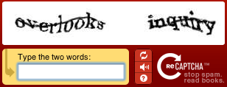
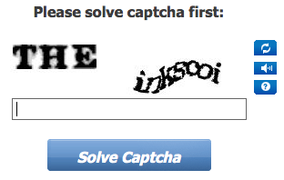
Optical Character Recognition (OCR)
CAPTCHA (Completely Automated Public Turing Test To Tell Computers and Humans Apart)
Notes:
A CAPTCHA is a program that protects websites against bots by generating and grading tests that humans can pass but current computer programs cannot.
CAPTCHA tests are based on open problems in artificial intelligence (AI): decoding images of distorted text, for instance, is well beyond the capabilities of modern computers.
The words in many of the captchas provided by reCaptcha come from scanned archival newspapers and old books.
by typing them in as a captcha, crowds teach computers to read the scanned text.
not only to increase fraud and spam protection for Google products but also to improve our books and newspaper scanning process
the technology behind Google Book project
Preventing Comment Spam in Blogs.
Protecting Website Registration, such as email service. Several companies (Yahoo!, Microsoft, etc.) offer free email services. Up until a few years ago, most of these services suffered from a specific type of attack: "bots" that would sign up for thousands of email accounts every minute.
Preventing Dictionary Attacks. CAPTCHAs can also be used to prevent dictionary attacks in password systems. The idea is simple: prevent a computer from being able to iterate through the entire space of passwords by requiring it to solve a CAPTCHA after a certain number of unsuccessful logins.

Slide 4


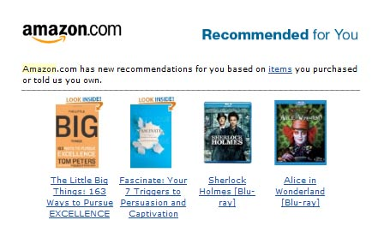
Machine Learning (ML)

Slide 5
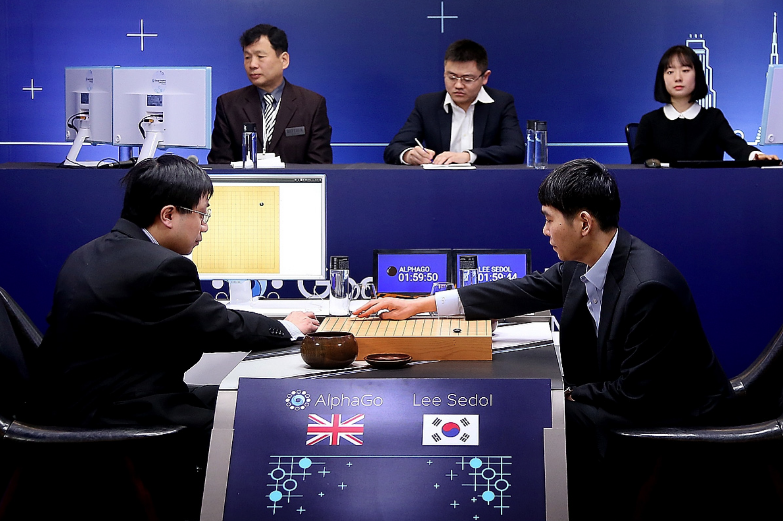
https://goo.gl/images/slBTEu

Slide 6
Machine Learning (ML)
Supervised Learning
classification
regression
Semi-supervised learning
Unsupervised Learning
PCA, MDS (aka PCoA)
Clustering (such as K-means)

Slide 7
Supervised Learning
Unsupervised Learning
x₂
x₂
x₁
x₁

Slide 8
Typical Data
response,
outcome,
dependent variables
predictors,
features,
attributes,
independent variables
Response may be continuous or categorical
Predictors may be
continuous, count, and/or binary
dense or sparse
observed and/or calculated

Slide 9
motivation
prediction
identify key taxa related to response
applications
environmental variables (PH, temperature, precipitation, N, P, etc.)
post mortem interval (PMI)
nutrition elements
drug dosage
any other continuous meta data
Notes:
many quantitative host phenotypes or environment factors are associated with shifts in bacterial communities
what's the minimum of nutrition elements to keep species A and maintain a healthy micriobiome

Slide 10
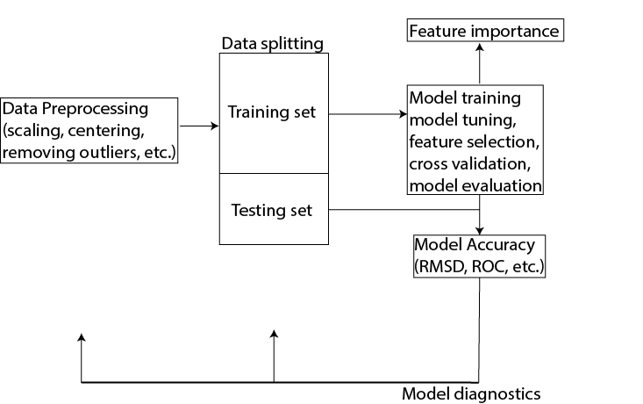
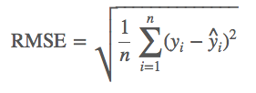
Process
Objective:

Slide 11
models
linear model and its variant (ridge, lasso, elastic net)
PLS (Partial Least Square)
KNN (K-nearest neighbor)
SVM
neural network
CART (classification and regression tree)
random forest
boosting trees

Slide 12
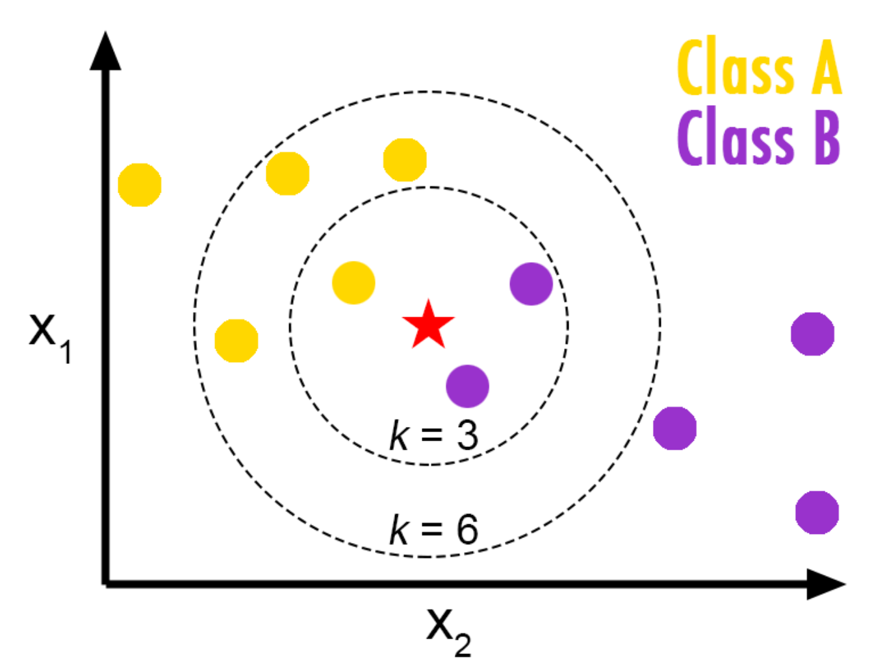
KNN
From http://bdewilde.github.io/blog/blogger/2012/10/26/classification-of-hand-written-digits-3/

Slide 13
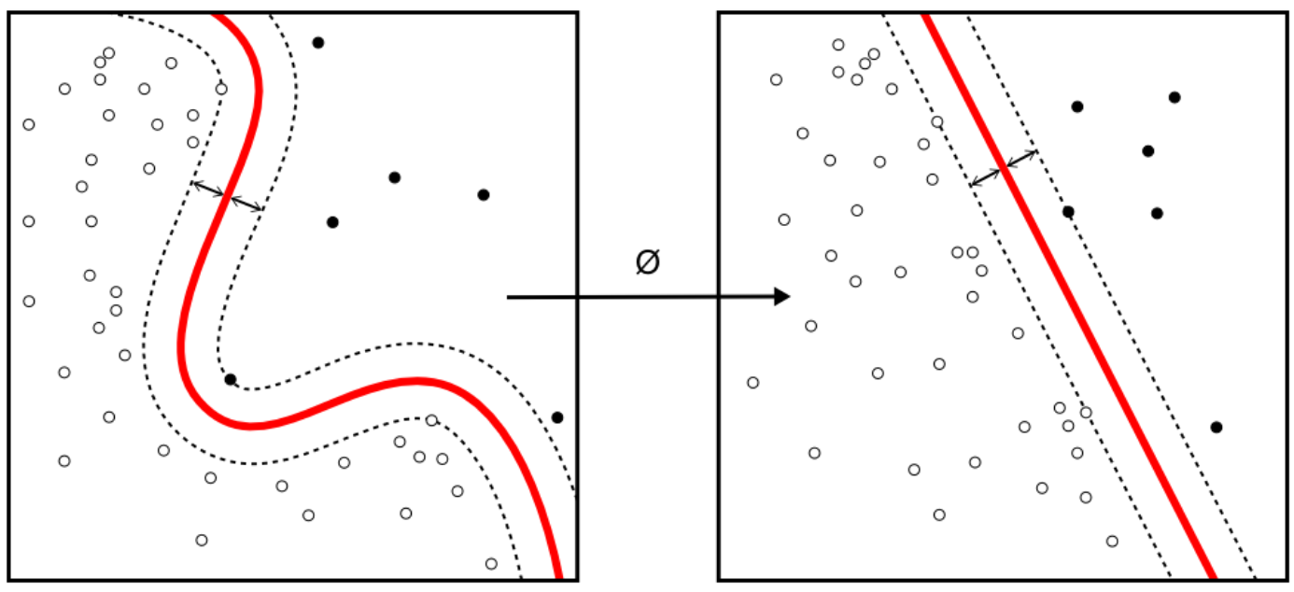
SVM
https://www.npmjs.com/package/node-svm

Slide 14
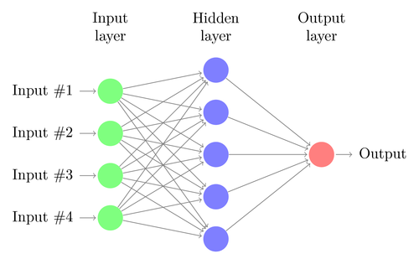
Neural Net
http://www.texample.net/tikz/examples/neural-network/

Slide 15
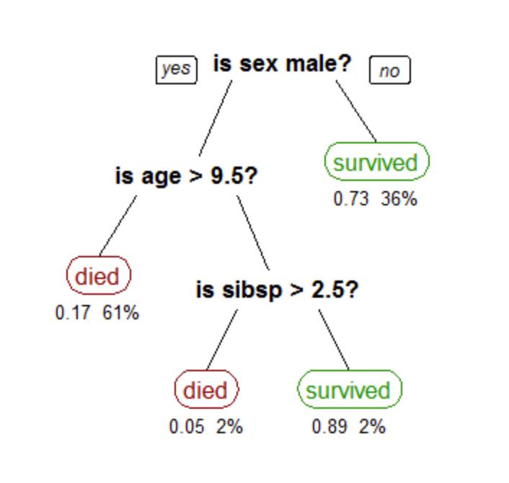
Tree
https://en.wikipedia.org/wiki/Decision_tree_learning#/media/File:CART_tree_titanic_survivors.png

Slide 16
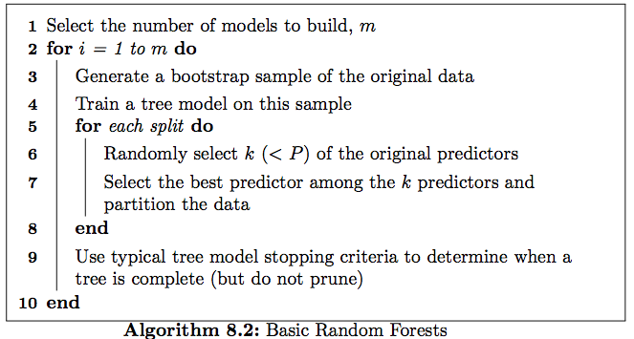
Random Forest
Applied Predictive Modeling by Kjell Johnson and Max Kuhn

Slide 17
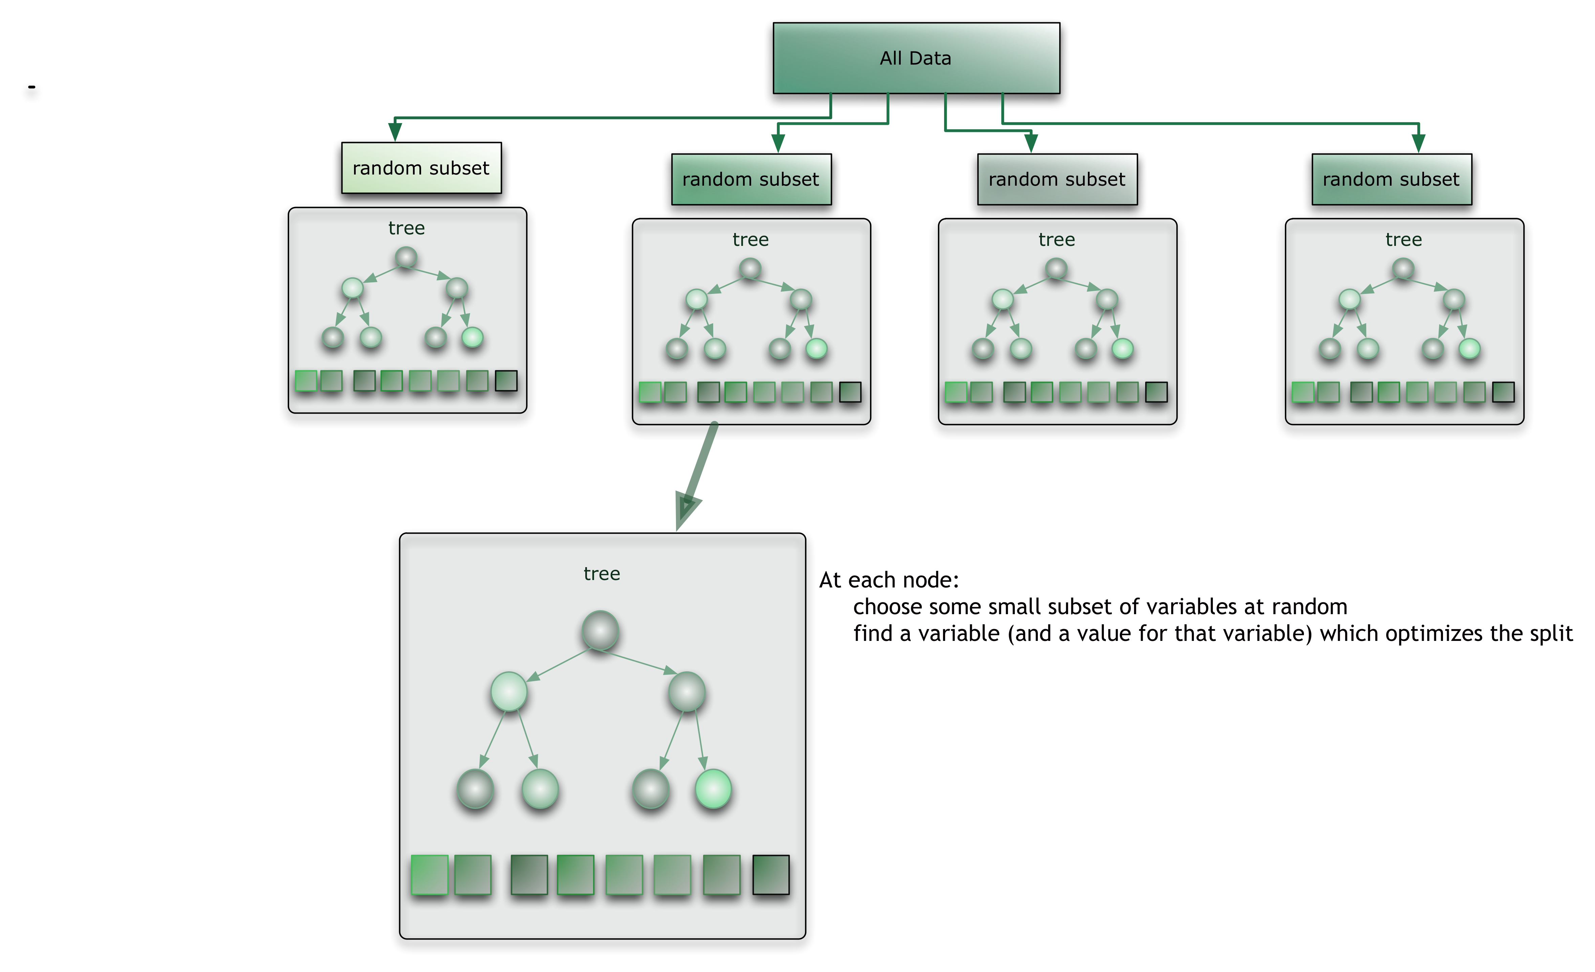
https://citizennet.com/blog/wp-content/uploads/2012/11/RF.jpg

